Slide 1
Emergency Preparedness
Disasters Are Inevitable.
However, The Outcome Is Not.

Slide 2
Government Recommendations

Slide 3
When We Think About Threats

Slide 4
Our Bodies React

Slide 5
We Tend To Ignore Or Avoid It

Slide 6
Hazards In Your Area High Winds

Slide 7
Flooding
I-5

Slide 8
Terrorism & Civil Unrest

Slide 9
Snow And Ice - Road Closures

Slide 10
Dept Of Natural Resources

Slide 11
Earthquakes

Slide 12
Hazards Are Real

Slide 13
Eating Beans For 7 Days Is Not A Balanced Diet

Slide 14
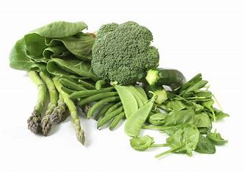
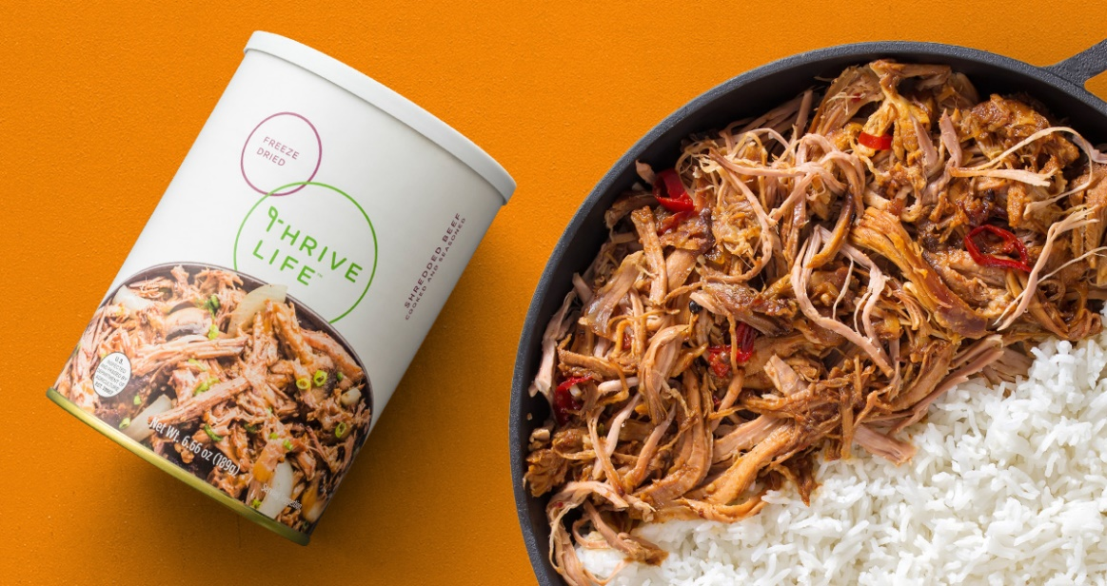
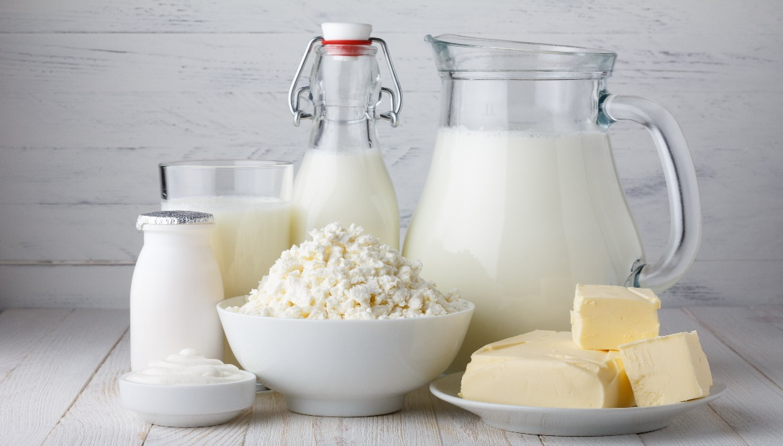
Balanced Foods Fruits, Vegetables, Meats & Dairy

Slide 15
The Worst Time To Prepare For An Emergency Is…..During One!

Slide 16
There Is No Downside In Being Prepared

Slide 17
Recent Disasters Have Shown Us
There is no cavalry waiting
to swoop down and rescue us.

Slide 18
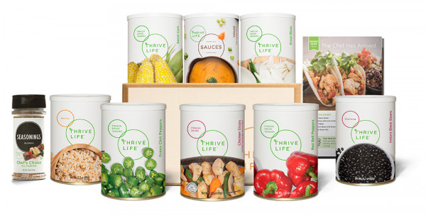
3 Tiers Of Food Storage

Slide 19
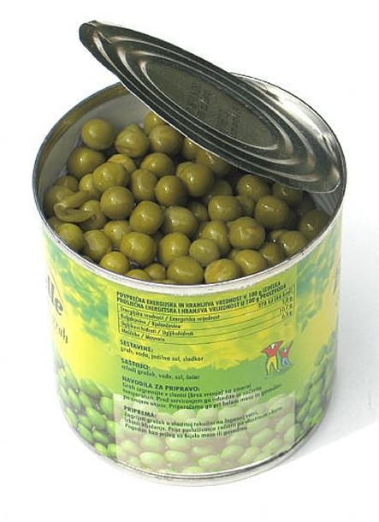
Nutrition
Fresh
Canned
Freeze-Dried

Slide 20
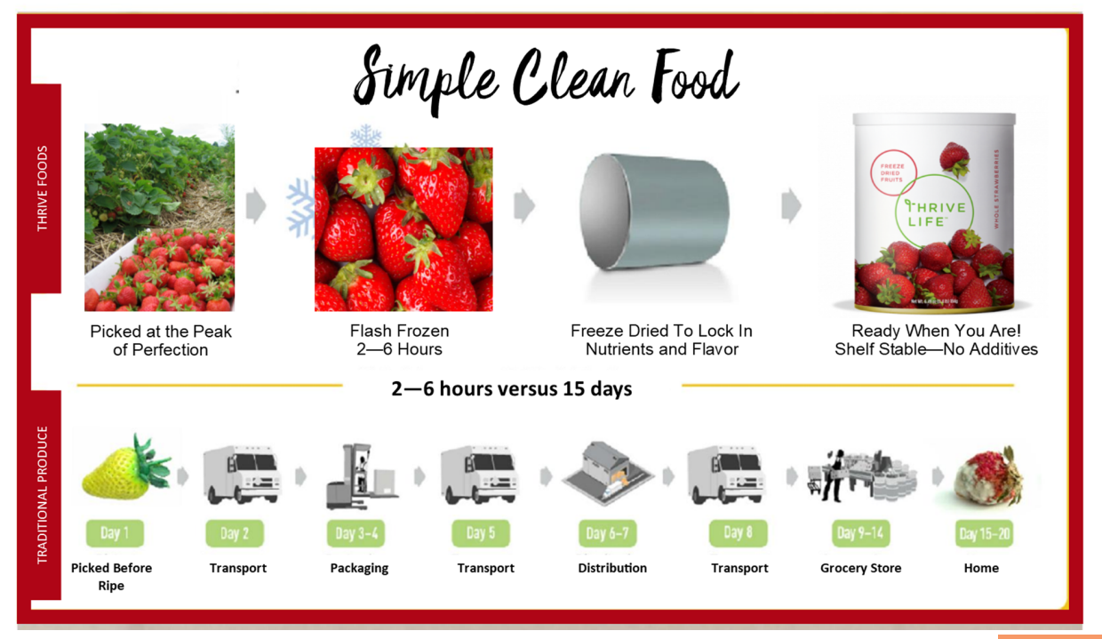
How Does Freeze Drying Work?

Slide 21
Into The Trash It Goes

Slide 22
Minimum Of 25% Is Thrown Away

Slide 23
25% Is $1500 A Year

Slide 24
What Do We All Need More Of ?

Slide 25
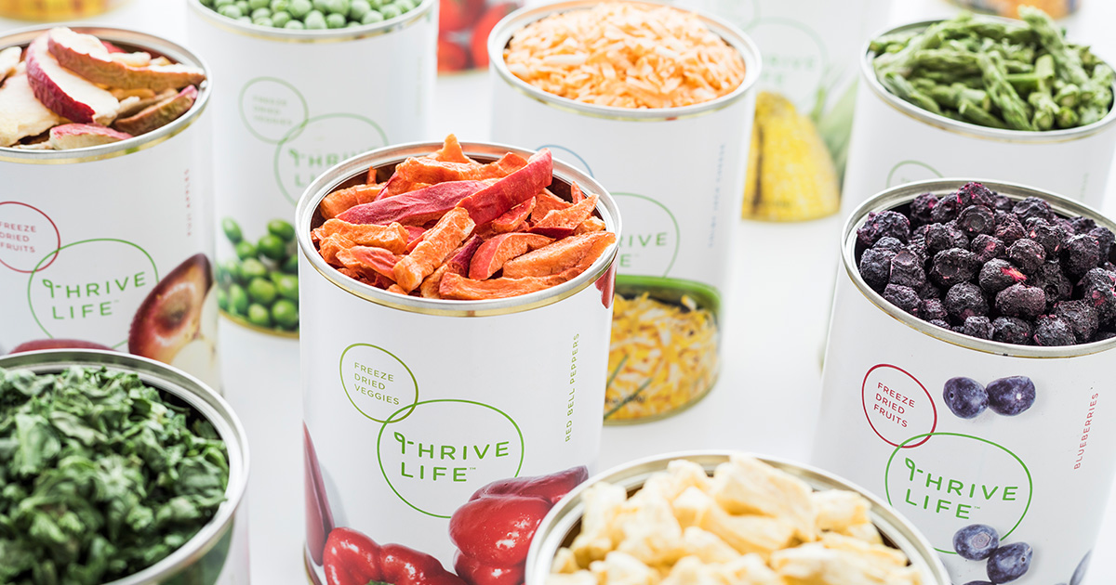
Delivery Plan
Lowest Prices
Special Sales
Free Shipping on orders over $100

Slide 26
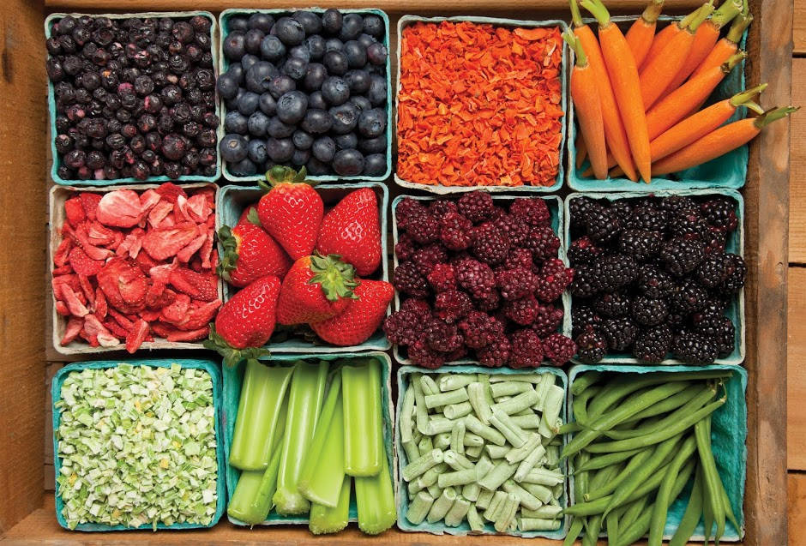
Delivery Plan
Helps You With Your Food Goal.
3 months
6 months
12 months
24 months

Slide 27
Delivery Plan
How Much Food Do I Need?
3.5 cups of food
per person per day
Number of days

Slide 28
Delivery Plan
How Much Food Is in Our Cans?
#10 Can
Pantry Can
11 cups
average
3.5 cups
average

Slide 29
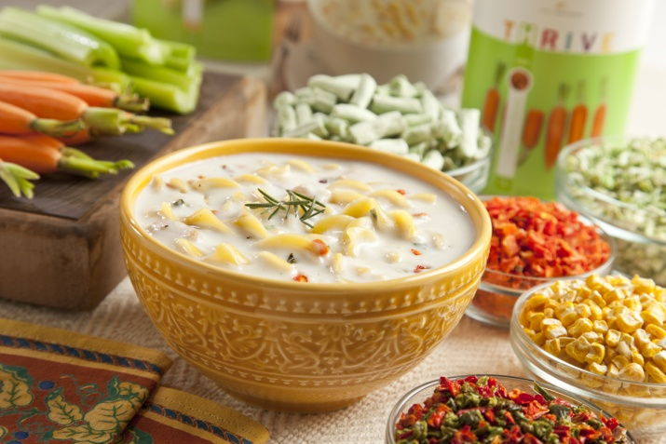
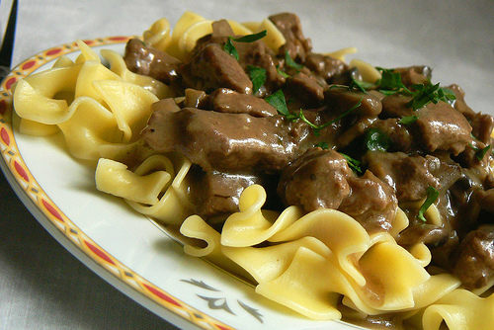
Veggies
Fruits
Dairy
Meat & Beans
Basics

Slide 30
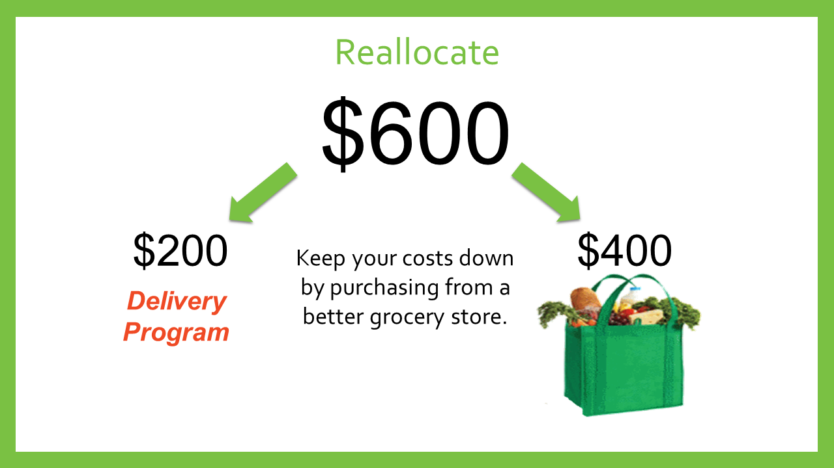
Delivery Plan

Slide 31
Delivery Plan
What’s Next?
Choose Your Start Date.
Pick Your Items.
Schedule a Party and Share with Others.

